Slide 1


UNIVERSITY OF MYSORE
MYSORE UNIVERSITY SCHOOL OF ENGINEERING
DEPARTMENT OF ARTIFICIAL INTELLIGENCE AND MACHINE LEARNING
MAJOR PROJECT PHASE –II (21AIP81)
Presentation on
“Real-time License Plate Detection & Unauthorized Vehicle Alerts”
PRESENTED BY
Faculty Incharge
Dr. K. S. Santhosh Kumar
Asst. Professor,
Dept. of AI&ML,
MUSE, UOM, Mysuru.
Sachitha V S (21SEAI29)
Sindhu S (21SEAI35)
Srujana H B (21SEAI37)
Varsha Y (21SEAI40)
Internal Guide
Mrs. Amreen Kouser
Asst. Professor,
Dept. of AI&ML,
MUSE, UOM, Mysuru.

Slide 2
Table of content
Introduction
Advantages and disadvantages
Literature Review Dataset description and images
Problem statement
Technologies used
Algorithms used
Proposed Methodology followed by 3 objectives
Results
Conclusion
Future developments
References

Slide 3
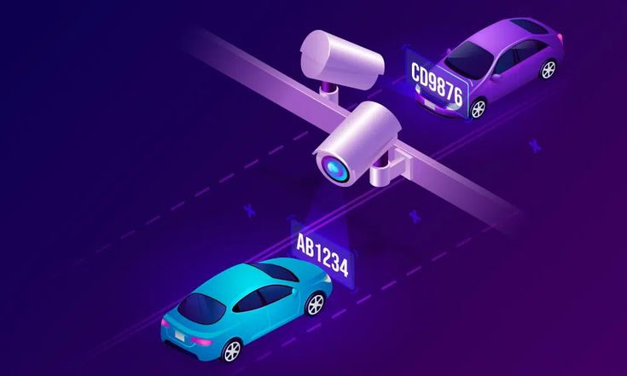
Real-time License Plate Detection & Unauthorized Vehicle Alerts
This presentation explores the technology, applications, and future of Number Plate Recognition and its applications in real-time video analysis.

Slide 4
Introduction :
Rapid Increase in Vehicle Population
Challenges in Manual Traffic Monitoring
.
Need for Automation
Role of License Plates in Vehicle Identification

Slide 5
Continue ...
Designing and Implementing a smart surveillance system that automatically detects vehicles and their license plates in video streams using object detection and optical character recognition (OCR).
The system cross-verifies detected plates with a blacklist stored in a MySQL database and, upon a match, generates an audible alert, a popup warning message, and logs the incident into the database.

Slide 6
Advantages
Integration of MySQL (RDBMS SOFTWARE) :
Real-Time Detection
Automation
Blacklist Alert System
User-Friendly Interface
Disadvantages
Lighting Sensitivity
Blurry or Angled Plates
OCR Character Confusion
Hardware Requirements
Video Quality Dependency

Slide 7
Literature Review:
Paper Title | Authors | Year | Methodology | Algorithm | Limitations
Automatic Number Plate Recognition: A Detailed Survey of Relevant Algorithms | Lubna, Naveed Mufti, Syed Afaq Ali Shah | 2021 | Systematic literature survey of ANPR methods: extraction → segmentation → recognition; performance comparison of various traditional/ML/deep‑learning algorithms | A wide spectrum of techniques evaluated, including: • Edge/Table-based extraction (Sobel, Canny, HOG, LBP, Hough) • Color and texture analysis • Deep‑learning methods (CNNs, TDNN) | Inconsistent comparisons—different datasets/methods hamper benchmarking • Environmental challenges (lighting, blur, skew, reflections) • Processing overhead for deep‑learning; hardware may be needed
Vehicle Number Plate Recognition System: A Literature Review and Implementation using Template Matching | Aniruddh Puranic, Deepak K. T., Umadevi V. | 2022 | Implementation using template matching | Template Matching, OCR | Low accuracy with varying fonts, lighting, skew; not robust for all plate types

Slide 8
Continue ...
Paper Title | Authors | Year | Methodology | Algorithm | Limitations
Implementation of Number Plate Detection System for Vehicle Under Different Environmental Conditions | M.A. Jawale P. William A.B. Pawar Nikhil Marriwala | 2023 | Pipeline using image preprocessing → plate localization (HLS color-based neural network) → morphological filtering → text extraction via PyTesseract OCR | HLS-based neural net for ROI detection - Morphological operations and edge-detection segmentation - OCR via PyTesseract for character extraction | Performance affected by motion blur, speed variations - Sensitive to non‑standard fonts and plate variations - Environmental conditions (lighting, angle) reduce accuracy
A Literature Survey on License Plate Recognition Using Various Techniques | Ratan Kumar (M.Tech Scholar), Prof.Devendra Patle (Associate Professor) | 2023 | Detailed survey categorizing LP detection/extraction approaches—color-based, edge-based, geometry-, clustering-, hybrid-, wavelet-, CNN-based methods; includes discussions of system pipelines and comparative tables | Color thresholding & histograms - Edge detection (Sobel, Canny, Prewitt) + morphology/Hough - Clustering (blob, corner, EM) - Hybrid combinations - CNN models like MD‑YOLO | Many methods rely on specific plate colors/layouts—poor generalization - Sensitive to lighting, blur, and skew - Varying dataset protocols hinder performance comparisons

Slide 9
Continue ...
Paper Title | Authors | Year | Methodology | Algorithm | Limitations
A literature review on automatic number plate recognition. | Soumya, Nikitha, and Swara, | 2024 | Edge detection, OCR, ML/DL approaches discussed | CCA, YOLO, OCR - all relevant | Blurriness, lighting, OCR errors, video quality
Automatic Number Plate Detection and Recognition System for Small‑Sized Number Plates of Category L‑Vehicles for Remote Emission Sensing Applications | Hafiz Hashim Imtiaz, Paul Schaffer, Paul Hesse, Martin Kupper, Alexander Bergmann | 2025 | Designed a specialized ANPR system (L‑ANPR) integrated with light‑barrier triggered cameras; tested in real-world EU campaigns; system pipeline: detection, preprocessing, recognition | Detection via CNN-based YOLOv4; character recognition using image conditioning (thresholding, dilation) + OCR on cropped plates | Low resolution on small plates can blur characters (~30–40% accuracy drop) - Shadows & sunlight hinder recognition (~20–30% loss) - YOLOv4 is aging; modern models could improve results

Slide 10
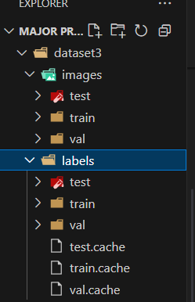
Dataset Description
Images Folder
Contains .jpg files of vehicle scenes captured in different environments.
Divided into train, val, and test sets for model development and evaluation.
Labels Folder
Each image has a corresponding .txt label file formatted in YOLO annotation format, which defines the bounding box of the plate.

Slide 11
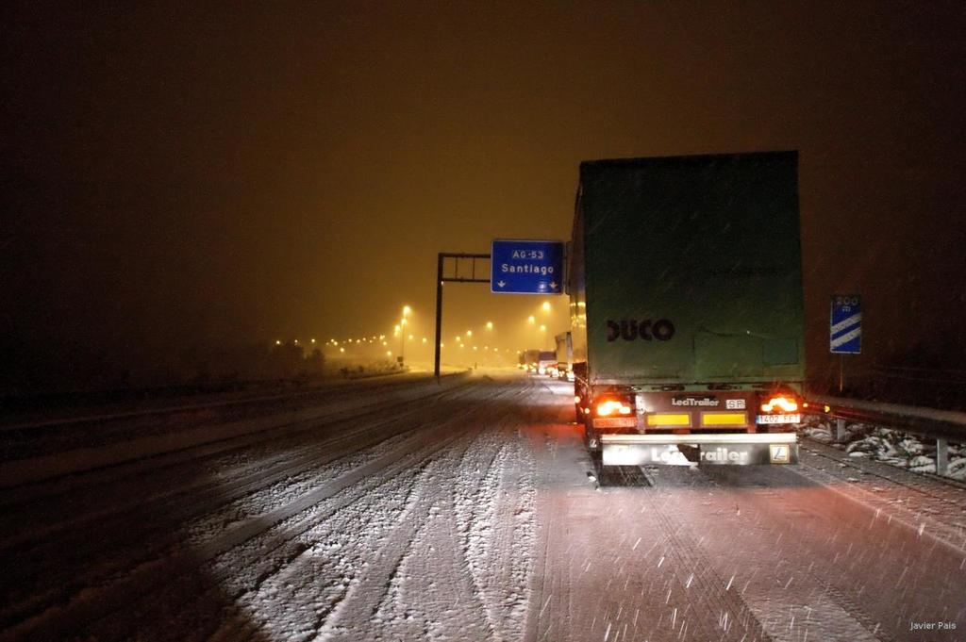
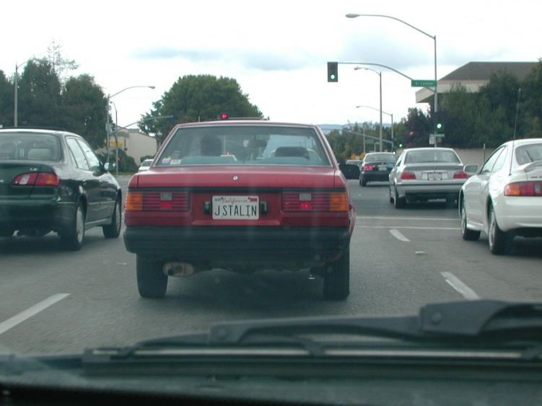
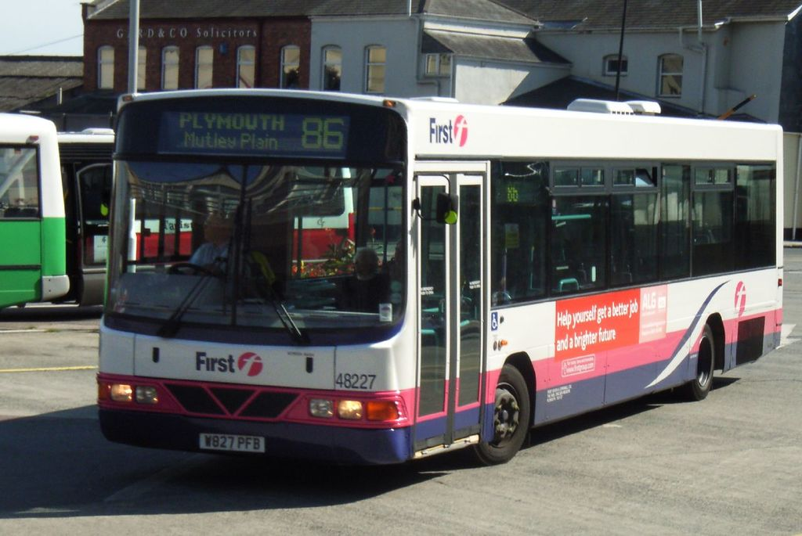
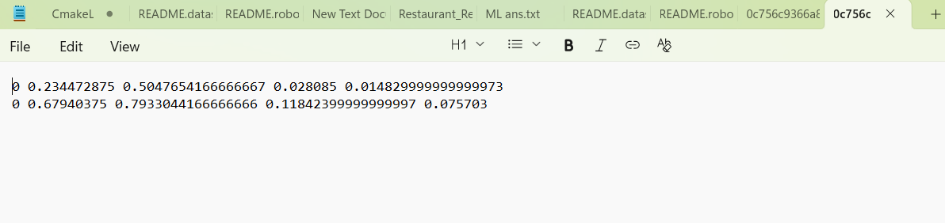
Data set images:
Figure 1 : Dataset image 1
Figure 2 : Dataset image 2
Figure 3 : Dataset image 3
Figure 4 : Label Annotation

Slide 12
Problem Statement:
Manual vehicle monitoring is inefficient and error-prone in today’s high-traffic, high-security environments. While AI-based ANPR systems improve automation, they struggle under poor lighting and video quality. This project uses YOLOv8 nano, Tesseract OCR, and MySQL to enable real-time detection, text extraction, and blacklist alerting for smarter surveillance.

Slide 13
Technologies used:
Python Programming Language
Purpose: For integrating all parts: video processing, YOLO detection, OCR, SQL interaction, alerts.
YOLO models (You Only Look Once ) : YOLOv8 Nano Model and YOLOv8 Custom Model
Description: Advanced real-time object detection model from Ultralytics.
Purpose: Fast and accurate detection of vehicles and license plates.
OpenCV
Description: Image and video processing library.
Purpose: To read video frames and save output.
Tesseract OCR
Description: Open-source Optical Character Recognition tool.
Purpose: To extract alphanumeric text from license plate regions.
MySQL + mysql-connector-python
Purpose: To store blacklisted plates and log detected plates with timestamps.
Tkinter + winsound
Description: GUI and sound modules in Python.
Purpose: To alert the user with a popup and sound when a blacklisted plate is detected.

Slide 14
Algorithms used:
YOLOv8 Nano: Smart tool to find vehicles and license plates.
Spots cars and plates in videos by drawing boxes around them.
Fast and small, works on regular computers.
Tesseract OCR: Reads license plate numbers from images.
Turns a picture of a plate into text (e.g., KA09MK1234).
Used after finding the plate to get the number.
IoU (Intersection over Union):
Checks if the same plate appears again.
Compares plate locations to avoid re-reading the same plate.
Saves time by reusing the text if the plate hasn't moved much.

Slide 15
Proposed Methodology:
Objective 1: Vehicle Detection Real-time Vehicle Detection using YOLOv8 Nano
Objective 2: License Plate Detection & OCR Use a custom-trained YOLOv8 model to locate license plates and extract text using Tesseract OCR.
Objective 3: Database Integration & Alert System
Database Integration and Alert System for Blacklisted Vehicles

Slide 16
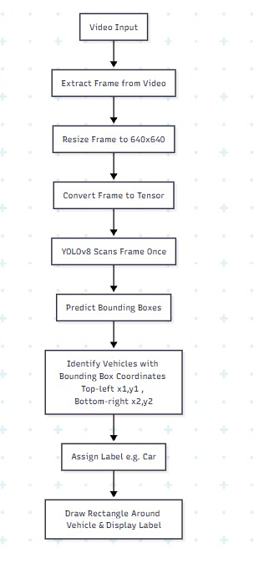
Objective 1:Vehicle Detection
Figure 5 : Framework for Objective I: Vehicle Detection Using YOLOv8

Slide 17
Continue...
1)Video Input: The process starts with a video input.
2)Extract Frame: Each frame is extracted and treated as a static image.
3)Resize Frame: The frame is resized to 640x640 (or the specified size).
4)Convert to Tensor: The frame is converted into a tensor for the neural network.
5)YOLOv8 nano Scans Frame: YOLOv8 nano processes the frame in a single pass.
6)Predict Outputs: It predicts bounding boxes, class scores, and confidence scores.
7)Identify Vehicles: Vehicles are identified with bounding box coordinates (x1, y1, x2, y2).
8)Assign Label and Confidence: Labels (e.g., 'Car') and confidence scores (e.g., 0.85) are assigned.
9)Draw Rectangle: A rectangle is drawn around each vehicle with the label and confidence displayed.
10)Move to Next Frame: The process repeats for the next frame until the video ends.

Slide 18
Dataset Training:
Training the Model to Find License Plates:
YOLOv8 Nano:
A small, fast tool that helps the computer spot license plates in videos.
Starts with a pre-built model (yolov8n.pt) that’s already good at finding objects.
Training Process:
Teaches the model to recognize license plates.
Studies the same set of pictures 5 times to learn better (epochs=5).
Uses pictures resized to a standard square size (imgsz=640).
Learns from 8 pictures at a time to save computer memory (batch=8).
Output:
Saves the trained model in a folder called LicensePlateTraining/yolov8n_custom_test.
Stores the learned skills for finding plates in videos.

Slide 19
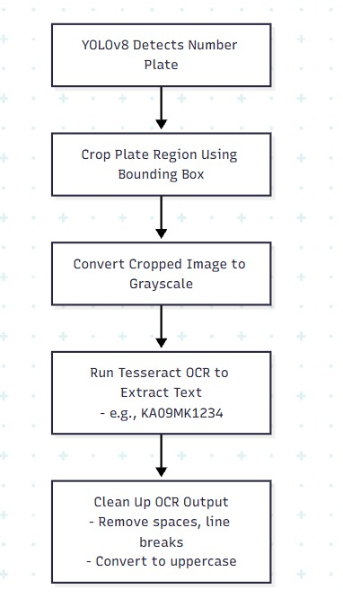
Objective 2:License Plate Detection & OCR
Figure 6 : Framework for Objective II: Framework for License Plate Detection and OCR

Slide 20
Continue...
YOLOv8 detects the number plate.
2) The plate region is cropped using the bounding box.
3) The cropped image is converted to greyscale.
4) Tesseract OCR extracts the text.
5) The OCR output is cleaned (removing spaces, line breaks, and converting to uppercase).
6) The clean plate number is used for SQL blacklist comparison, display, and alerts

Slide 21
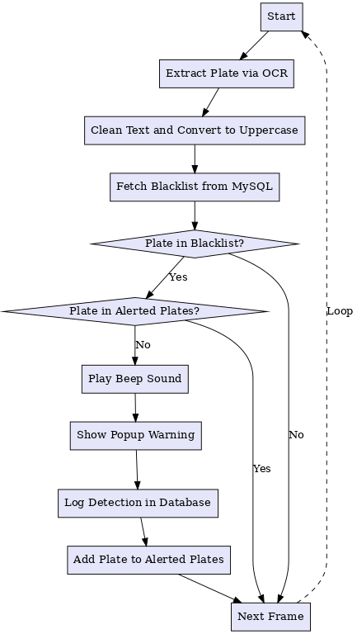
Objective 3:Database Integration and
Alert System
Figure 7 : Framework for Objective III: Database Integration and Alert Mechanism

Slide 22
Continue...
1)Checking the Blacklist:
Uses MySQL database with two tables:
i)blacklist: Stores problematic license plate numbers (e.g., KA09MK1234 for stolen cars).
ii)detected_plates: Records all detected plates with timestamps.
Extracts plate number using OCR and cleans it (e.g., removes spaces, converts to uppercase).Compares cleaned plate number with blacklist table to check for a match.
2) Alerting the User:
If plate is in blacklist and not previously alerted: Plays a beep sound using winsound to grab attention. Displays a popup warning using tkinter (e.g., “Blacklisted Plate Detected: KA09MK1234”).Adds plate to alerted_plates list to prevent repeat alerts in the same session.
Saves detection details (plate, timestamp) in detected_plates table.
3) Continuous Monitoring:
After processing a frame (alerted or not), moves to the next video frame.Repeats the process: extract, clean, compare, alert, and log. Ensures real-time monitoring to catch blacklisted plates instantly.

Slide 23
Results
Objective | Component | Accuracy | Precision | Recall | Latency
Objective 1 | YOLOv8 Vehicle Detection | 0.93 | 0.94 | 0.91 | 38 ms/frame
Objective 2 | Plate Detection + OCR | 0.87 | 0.89 | 0.86 | 120 ms
Objective 3 | DB Match + Alert + Logging | 1.00 | 1.00 | 1.00 | 360 ms
Table 1: Objective-Wise Performance Summary

Slide 24
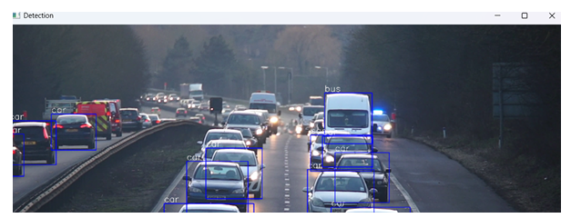
Continue...
Figure 4: Objective I – Vehicle Detection using YOLOv8.

Slide 25
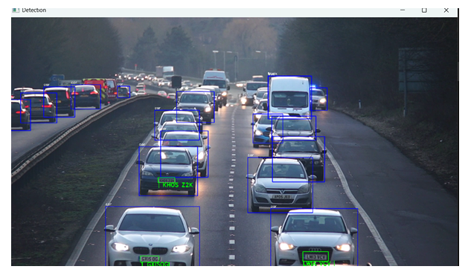
Continue...
Figure 5: Objective II – YOLOv8 Vehicle Detection

Slide 26
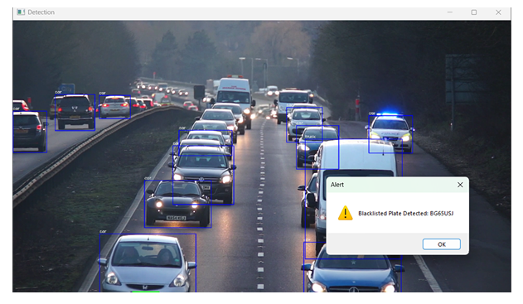
Continue...
Figure 6: Objective III – Alert + Logging.

Slide 27
Conclusion
Successfully developed a smart system for real-time vehicle detection and license plate recognition
Used YOLOv8 for fast and accurate detection from video frames
Applied Tesseract OCR to extract and log license plate data automatically
Integrated a MySQL database to manage blacklisted vehicles and generate alerts
Practical use in campuses, institutions, parking areas, and entry gates

Slide 28
Future Developments
Model Enhancement: Expand training data and epochs for better detection in diverse conditions
Advanced OCR Integration: Use models like CRNN or Paddle OCR for improved accuracy
Multi-Object Detection: Extend to detect vehicle type, driver, or helmet compliance
Alert System Upgrade: Enable SMS/email alerts for blacklisted vehicles
Police Station Integration: Auto-notify local police authorities when blacklisted vehicles are detected
Web Dashboard: Add UI for live feeds, reports, and analytics

Slide 29
Reference
Aniruddh Puranic, Deepak K. T., Umadevi V. , Vehicle Number Plate Recognition System:A Literature Review and Implementation using Template Matching, 2022
Hafiz Hashim Imtiaz, Paul Schaffer, Paul Hesse, Martin Kupper, Alexander Bergmann, Automatic Number Plate Detection and Recognition System for Small‑Sized Number Plates of Category L‑Vehicles for Remote Emission Sensing Applications, 2025
M.A. Jawale,P. William, A.B. Pawar, Nikhil Marriwala, Implementation of Number Plate Detection System for Vehicle Under Different Environmental Conditions,2023
Lubna, Naveed Mufti, Syed Afaq Ali Shah , Automatic Number Plate Recognition: A Detailed Survey of Relevant Algorithms, 2021
Ratan Kumar (M.Tech Scholar), Prof.Devendra Patle (Associate Professor) A Literature Survey on License Plate Recognition Using Various Techniques, 2023
Soumya,Nikitha, andSwara, “Aliterature review on automatic numberplate recognition,” 2024.

Slide 30
Any
Suggestions
or
Questions

Slide 31
Thank you

